Slide 1
Vanadium figures

Slide 2
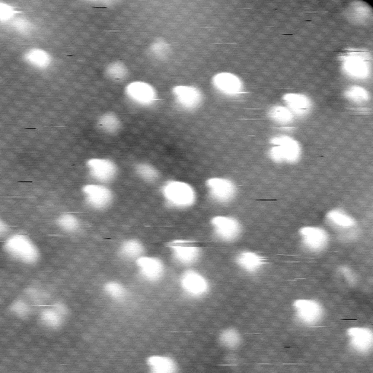

Slide 3
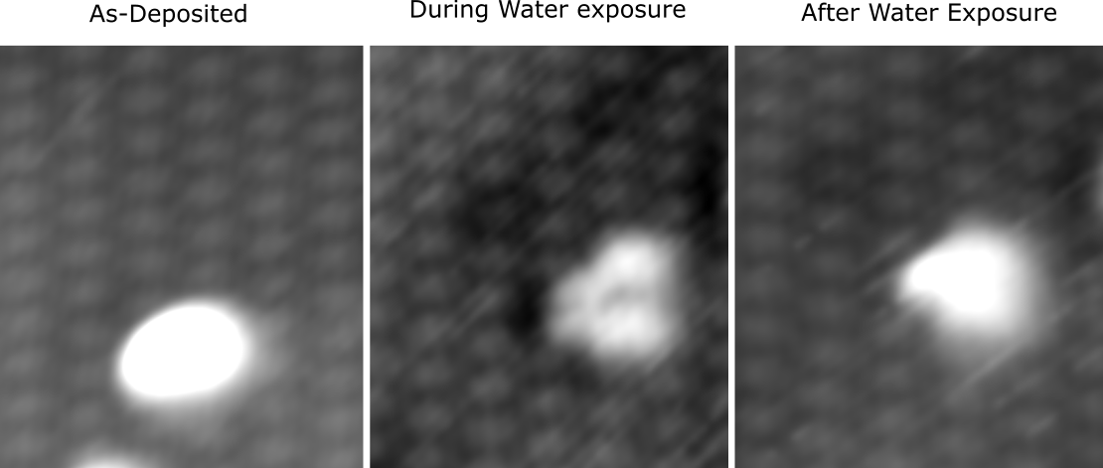

Slide 4
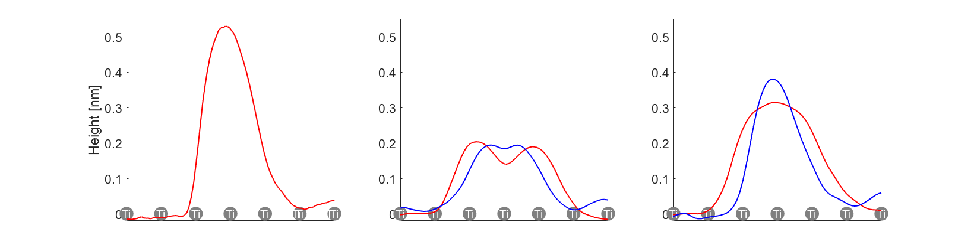

Slide 5
model suggestions
= V
V2O5
2 X VO3H
V2O5

Slide 6
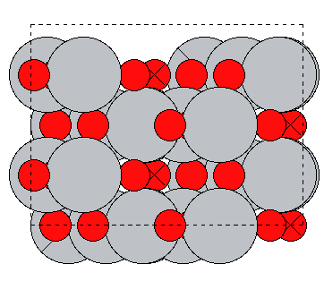
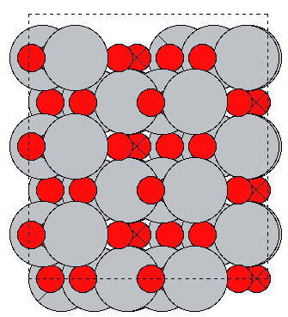
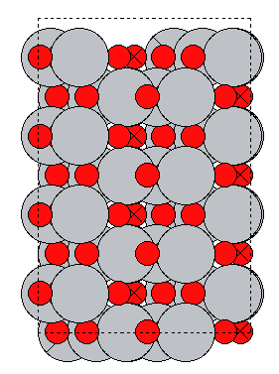
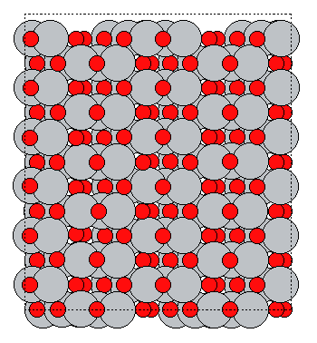
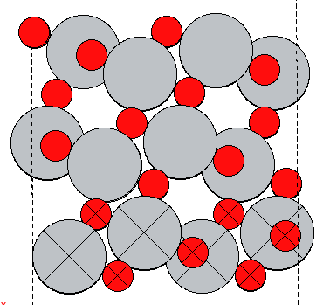
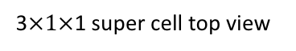
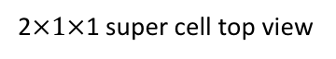
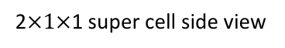
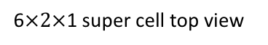
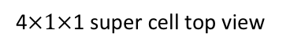
Methodology
2$×1×$1 super cell top view
3$×1×$1 super cell top view
4$×1×$1 super cell top view
6$×2×$1 super cell top view
2$×1×$1 super cell side view

Slide 7
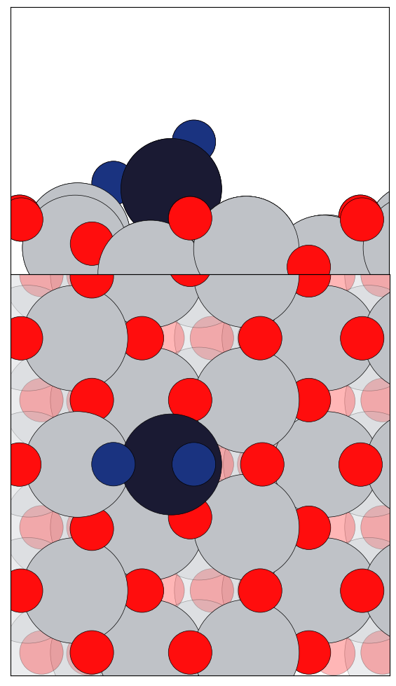
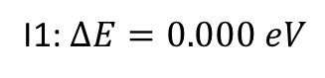
VO₂ Clusters with O_{v} (1by2 Super cell)
I1: $∆E=0.000 eV$

Slide 8
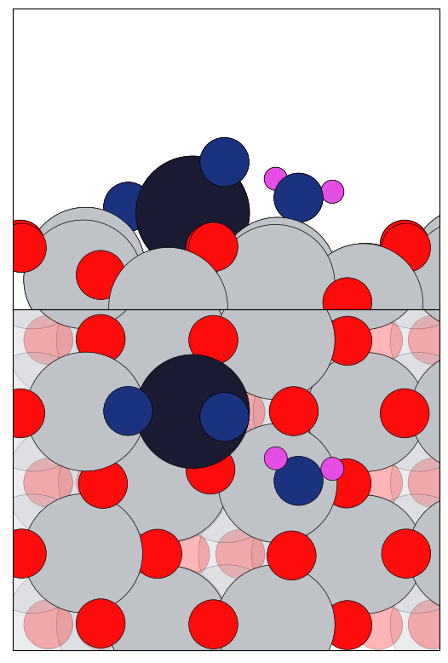
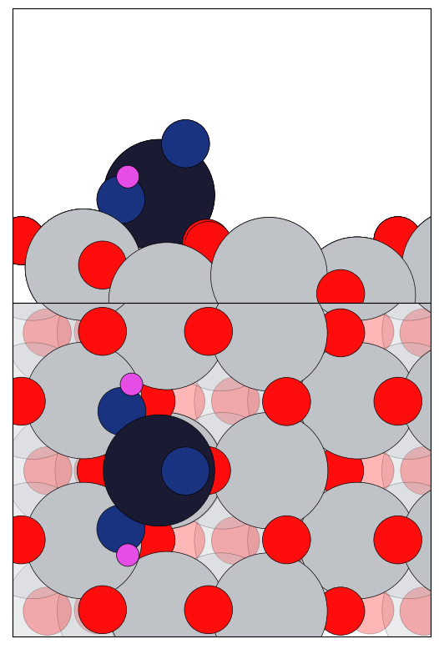
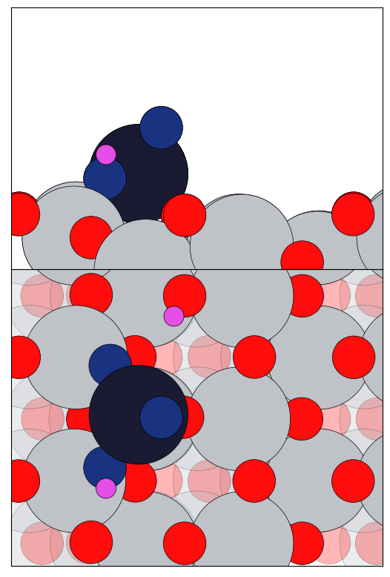
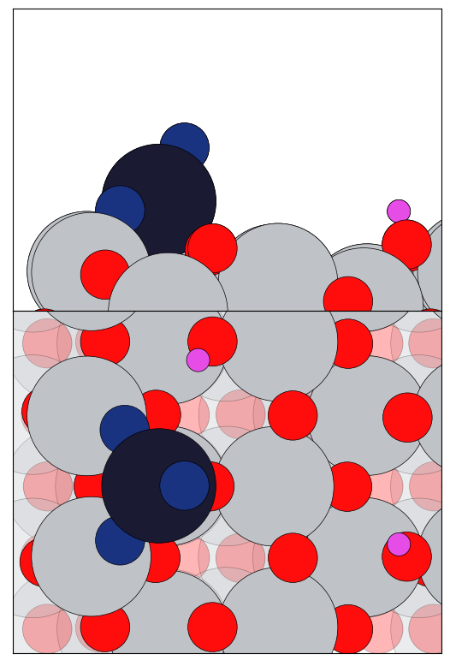
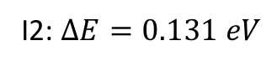
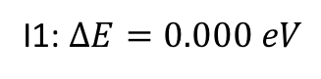
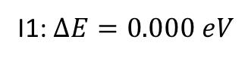
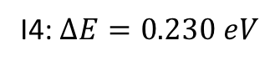
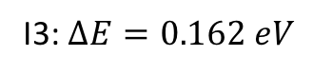
VO₂ + H₂O Clusters with O_{v} (1by2 Super cell)
I1: $∆E=0.000 eV$
I1: $∆E=0.000 eV$
I2: $∆E=0.131 eV$
I3: $∆E=0.162 eV$
I4: $∆E=0.230 eV$

Slide 9
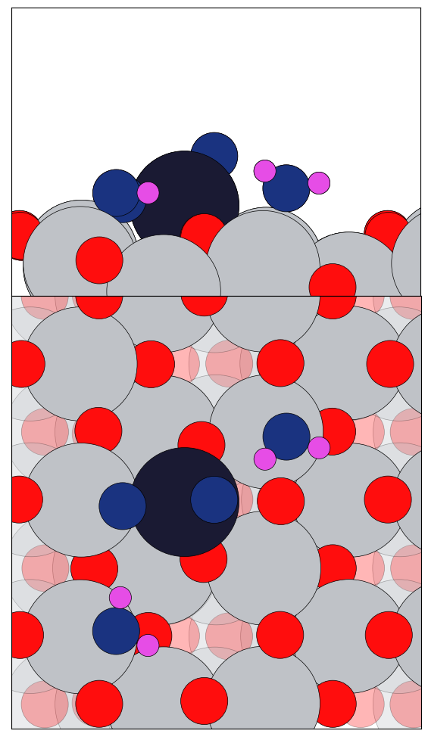
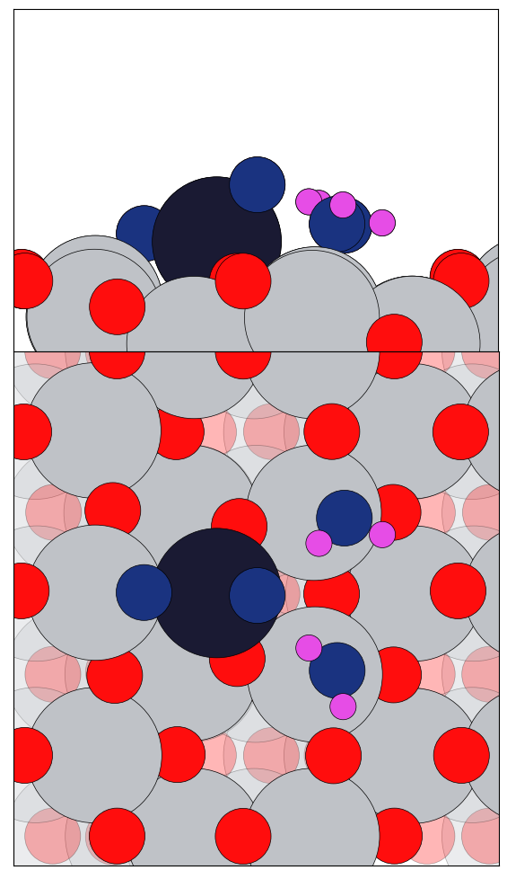
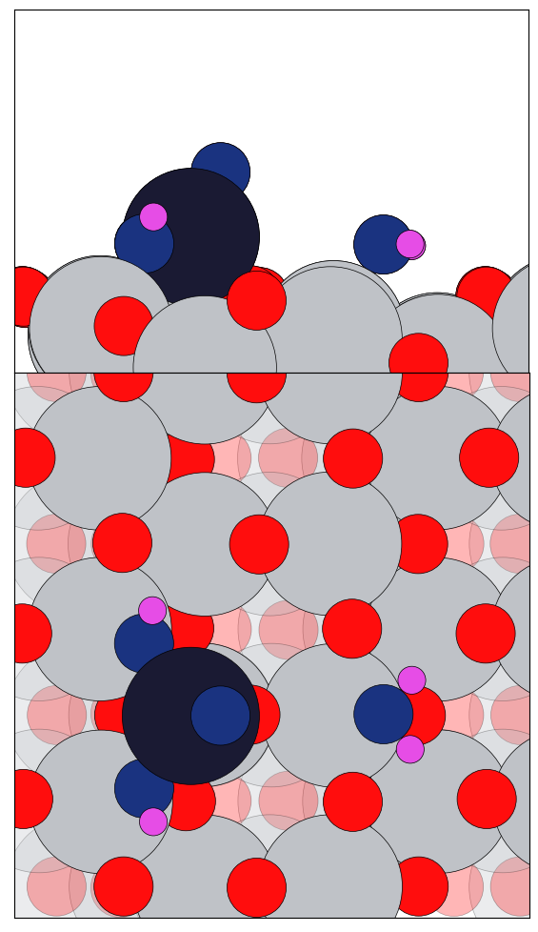
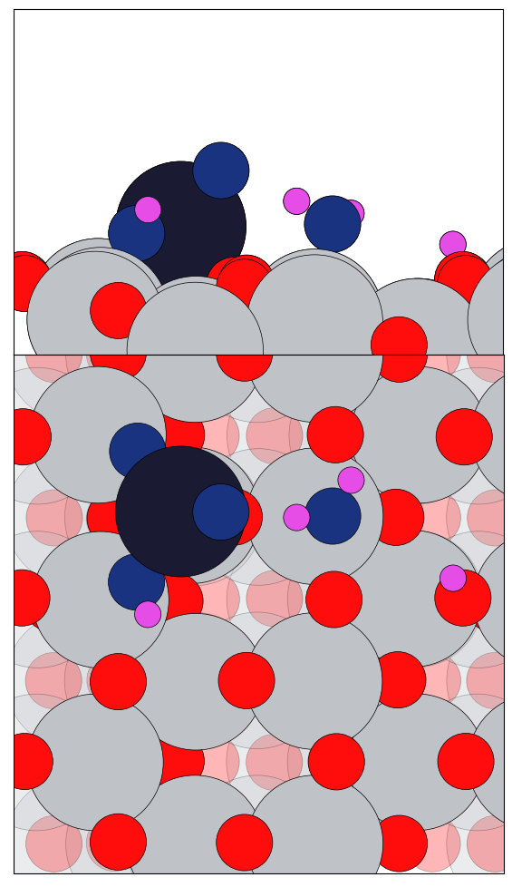
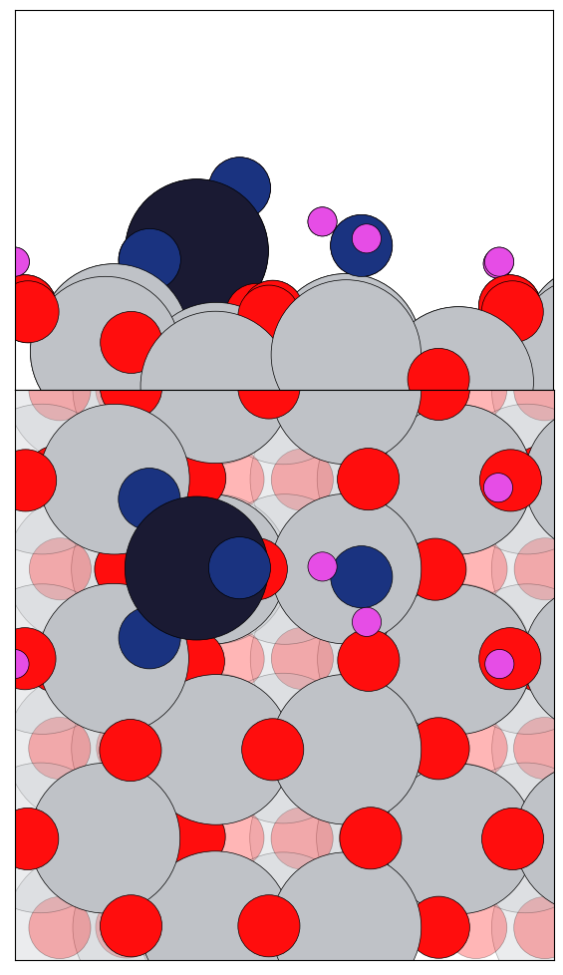
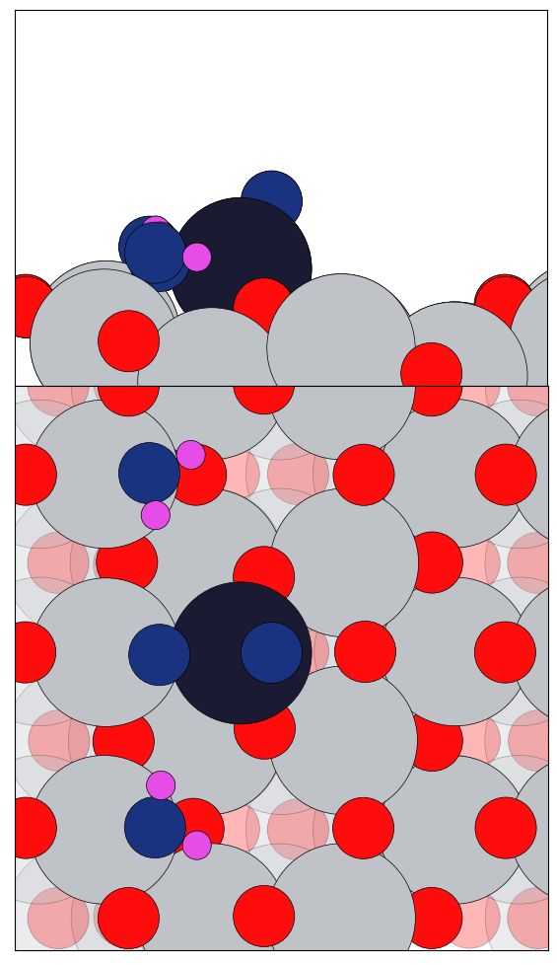
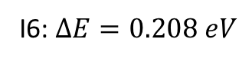
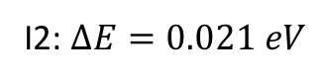
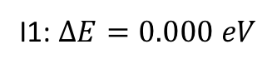
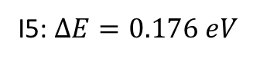
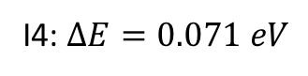
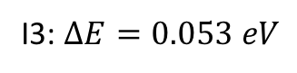
VO₂ + 2H₂O Clusters with O_{v} (1by3 Super cell)
I1: $∆E=0.000 eV$
I2: $∆E=0.021 eV$
I3: $∆E=0.053 eV$
I4: $∆E=0.071 eV$
I5: $∆E=0.176 eV$
I6: $∆E=0.208 eV$

Slide 10
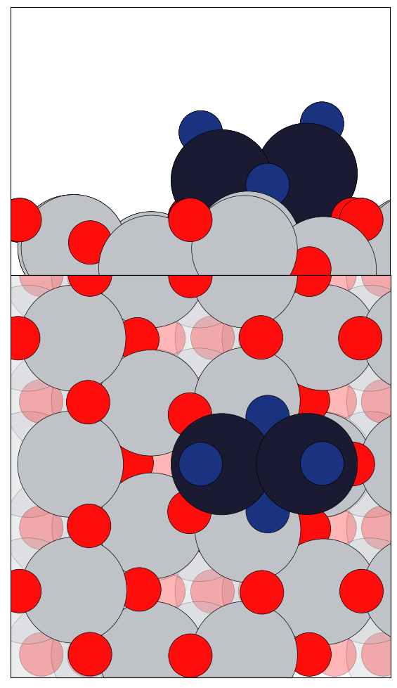
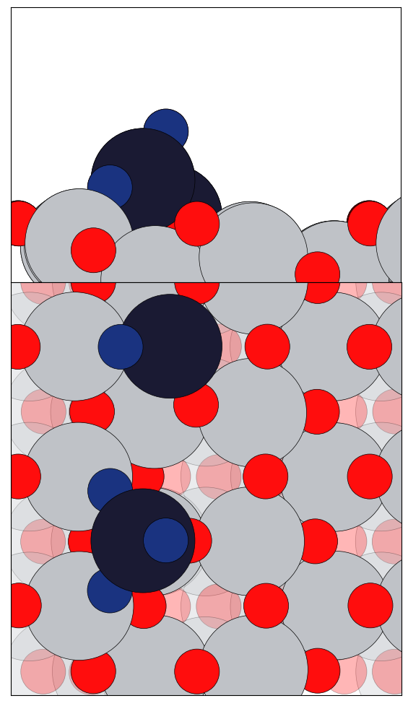
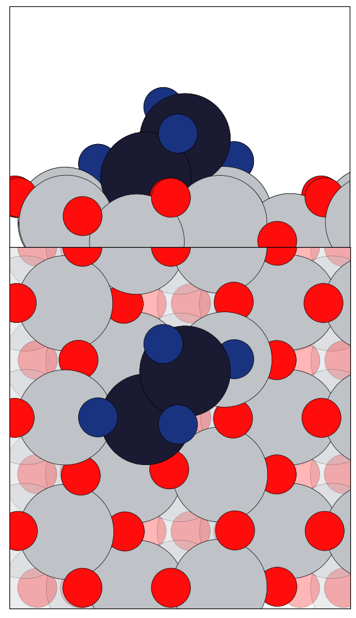
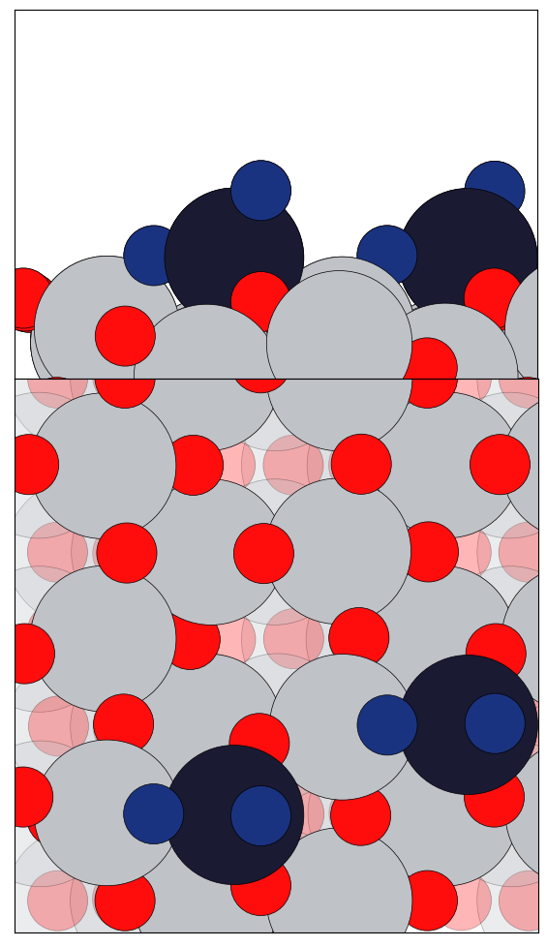
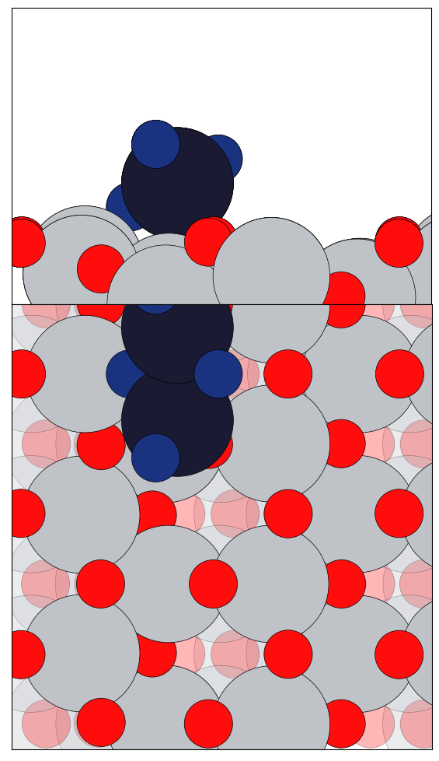
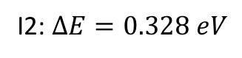
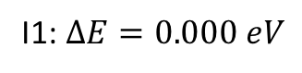
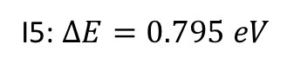
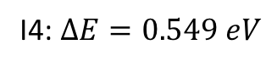
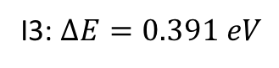
V₂O₄ Clusters with O_{v} (1by3 Super cell)
I1: $∆E=0.000 eV$
I2: $∆E=0.328 eV$
I3: $∆E=0.391 eV$
I4: $∆E=0.549 eV$
I5: $∆E=0.795 eV$

Slide 11
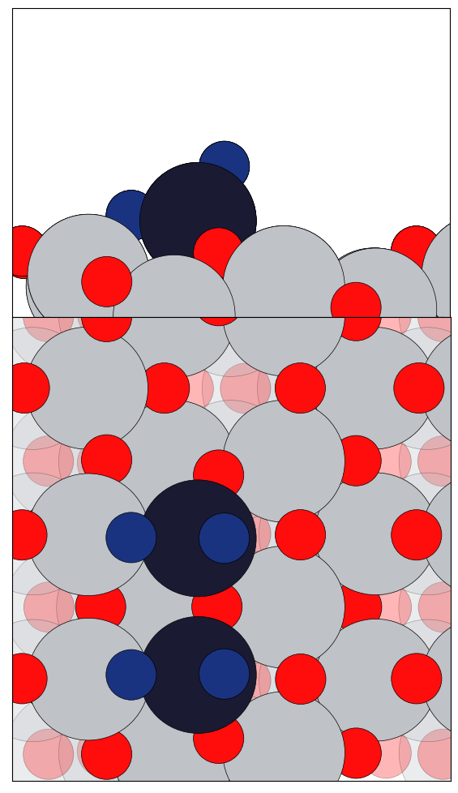
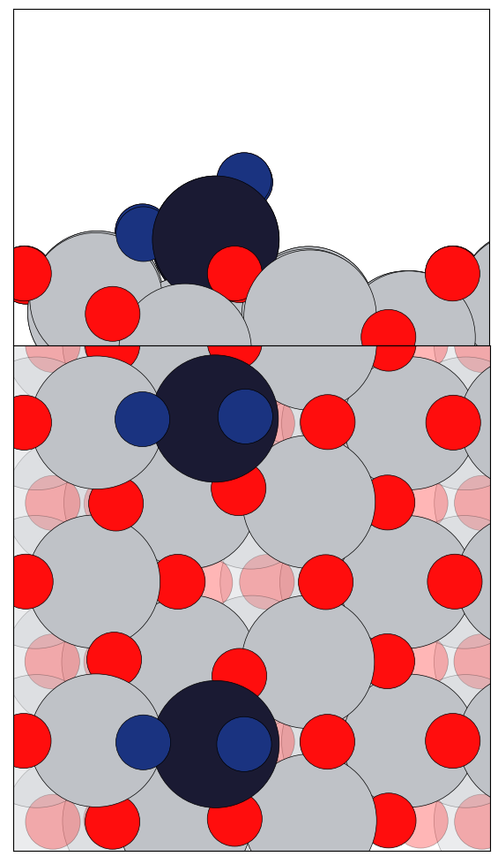
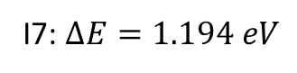
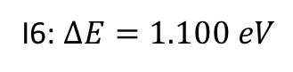
V₂O₄ Clusters with O_{v} (1by3 Super cell)
I6: $∆E=1.100 eV$
I7: $∆E=1.194 eV$

Slide 12











V₂O₄ + H₂O Clusters with O_{v} (1by3 Super cell)
I1: $∆E=0.000 eV$
I2: $∆E=0. 417eV$
I3: $∆E=0.468eV$
I4: $∆E=0.600 eV$
I5: $∆E=0.664 eV$
I6: $∆E=0.703 eV$

Slide 13








V₂O₄ + H₂O Clusters with O_{v} (1by3 Super cell)
I7: $∆E=0.837 eV$
I8: $∆E=0.931 eV$
I9: $∆E=0.982 eV$
I10: $∆E=1.180 eV$

Slide 14









V₂O₄ + 2H₂O Clusters with O_{v} (1by3 Super cell)
I1: $∆E=0.000 eV$
I2: $∆E=0.409 eV$
I3: $∆E=0.541 eV$
I4: $∆E=0.574 eV$
I5: $∆E=0.633 eV$

Slide 15










V₂O₄ + 2H₂O Clusters with O_{v} (1by3 Super cell)
I6: $∆E=0.803 eV$
I7: $∆E=0.837 eV$
I8: $∆E=0.874 eV$
I9: $∆E=0.989 eV$
I10: $∆E=1.059 eV$

Slide 16












V₂O₅ Clusters with O_{v} (1by4 Super cell)
I1: $∆E=0.000 eV$
I2: $∆E=0.127 eV$
I3: $∆E=0.131 eV$
I4: $∆E=0.257 eV$
I5: $∆E=0.326 eV$
I6: $∆E=0.420 eV$

Slide 17











V₂O₅ Clusters with O_{v} (1by4 Super cell)
I6: $∆E=0.420 eV$
I7: $∆E=0.814 eV$
I8: $∆E=1.065 eV$
I9: $∆E=1.164 eV$
I10: $∆E=1.244 eV$
I11: $∆E=2.238 eV$

Slide 18



































V₂O₅ Clusters with O_{v} (1by4 cell)
$$V2O5+ H2O \underset{→}{TiO2 \left(101\right) surface O vacancy}$$
I1: $∆E=0.000 eV$
I2: $∆E=0.002 eV$
I4: $∆E=0.006 eV$
I5: $∆E=0.068 eV$
I6: $∆E=0.078 eV$
I7: $∆E=0.103 eV$
I8: $∆E=0.106 eV$
I9: $∆E=0.133 eV$
I10: $∆E=0.165 eV$
I11: $∆E=0.168 eV$
I12: $∆E=0.169 eV$
I13: $∆E=0.183 eV$
I14: $∆E=0.199 eV$
I15: $∆E=0.232 eV$
I16: $∆E=0.273 eV$
I17: $∆E=0.282 eV$
I18: $∆E=0.295 eV$

Slide 19
























V₂O₅ Clusters with O_{v} (1by4 cell)
$$V2O5+ H2O \underset{→}{TiO2 \left(101\right) surface O vacancy}$$
I19: $∆E=0.330 eV$
I20: $∆E=0.341 eV$
I21: $∆E=0.343 eV$
I22: $∆E=0.397 eV$
I23: $∆E=0.429 eV$
I24: $∆E=0.484 eV$
I25: $∆E=0.513 eV$
I26: $∆E=0.522 eV$
I27: $∆E=0.575 eV$
I28: $∆E=0.605 eV$
I29: $∆E=0.629 eV$
I30: $∆E=0.762 eV$

Slide 20

































V₂O₅ Clusters with O_{v} (1by4 Super cell)
$$V2O5+2 H2O \underset{→}{TiO2 \left(101\right) surface O vacancy}$$
I1: $∆E=0.000 eV$
I2: $∆E=0.046 eV$
I3: $∆E=0.053 eV$
I4: $∆E=0.120 eV$
I5: $∆E=0.147 eV$
I6: $∆E=0.153 eV$
I7: $∆E=0.154 eV$
I8: $∆E=0.165 eV$
I10: $∆E=0.170 eV$
I11: $∆E=0.196 eV$
I12: $∆E=0.218 eV$
I13: $∆E=0.227 eV$
I14: $∆E=0.232 eV$
I15: $∆E=0.244 eV$
I16: $∆E=0.253 eV$
I17: $∆E=0.260 eV$

Slide 21

































V₂O₅ Clusters with O_{v} (1by4 Super cell)
$$V2O5+2 H2O \underset{→}{TiO2 \left(101\right) surface O vacancy}$$
I18: $∆E=0.280 eV$
I19: $∆E=0.283 eV$
I20: $∆E=0.292 eV$
I21: $∆E=0.294 eV$
I22: $∆E=0.317 eV$
I23: $∆E=0.362 eV$
I24: $∆E=0.382 eV$
I25: $∆E=0.412 eV$
I26: $∆E=0.425 eV$
I27: $∆E=0.439 eV$
I28: $∆E=0.443 eV$
I29: $∆E=0.447 eV$
I30: $∆E=0.448 eV$
I31: $∆E=0.474 eV$
I32: $∆E=0.581 eV$
I33: $∆E=0.631 eV$

Slide 22














V₂O₅ Clusters with O_{v} (1by4 Super cell)
$$V2O5+2 H2O \underset{→}{TiO2 \left(101\right) surface O vacancy}$$
I34: $∆E=0.643 eV$
I35: $∆E=0.736 eV$
I36: $∆E=0.790 eV$
I37: $∆E=0.795 eV$
I38: $∆E=0.805 eV$
I39: $∆E=0.836 eV$
I40: $∆E=1.22 eV$

Slide 23






V₂O₅ Clusters with O_{v} (1by4 cell) for paper
$$∆E=0.000 eV$$
$$∆E=0.107 eV$$
$$∆E=0.249 eV$$
$$∆E=0.669 eV$$
$$∆E=0.776 eV$$
$$∆E=0.865 eV$$

Slide 24










V₂O₅ 1H₂O and V₂O₅ 2H₂O Clusters with O_{v} (1by4 cell) for paper
$$∆E=0.000eV$$
$∆E=0.056eV$
$$∆E=0.082 eV$$
$∆E=0.293 eV$
$$∆E=0.394 eV$$
$$∆E=0.000 eV$$
$∆E=0.031 eV$
$∆E=0.100 eV$
$∆E=0.175 eV$
$∆E=0.467 eV$

Slide 25

Method Vs Energy Order
I₁
I₂
I₃
I₄
Method (f_{cut}=0.023 eV/Ang) | I₁/$∆E(eV)$ (O_{v}) | I₂/$∆E(eV)$(O_{v}) | I₃/$∆E(eV)$(O_{v}) | I₄/$∆E(eV)$(O_{v})
GPAW (PW(500 eV),PBE,dzp,(2,2,1)) | 0.00 | -0.476 | -0.103 | -0.411
GPAW (PW(500 eV),PBE,dzp,(2,2,1), U(4.0)) | 0.000 | 0.006 | 0.106 | 0.124
GPAW (PW(500 eV),PBE,dzp,(4,4,1), U(4.0)) | 0.000 | 0.006 | 0.106 | 0.123
CP2K (GPW(400 Ry),PBE,dzvp) | 0.000 | -1.154 | -0.745 | -0.951
CP2K (GPW(400 Ry),PBE,dispersion (dftd3),dzvp) | 0.000 | -1.017 | -0.584 | -0.719

Slide 26





















Method Vs Energy Order
M₁ = CP2K (GPW(400 Ry),PBE,dzvp)
M₂ = GPAW (PW(500 eV),PBE,dzp,(2,2,1))
M₃ = GPAW (PW(500 eV),PBE,dzp,(2,2,1), U(4.0))
M₁ : $∆E=0.000 eV$
M₁: $∆E=−1.154 eV$
M₁ : $∆E=−\text{0.95}\text{1 }eV$
M₁ : $∆E=−0.764 eV$
M₁ : $∆E−0.745 eV$
M₁ : $∆E=−0.742 eV$
M₁ : $∆E=0. 159eV$
M₂: $∆E=0.000 eV$
M₂: $∆E=−0.405 eV$
M₂: $∆E=−0.302 eV$
M₂: $∆E=0.061eV$
M₂: $∆E=0.102 eV$
M₂: $∆E=0.095 eV$
M₂: $∆E=−0.230 eV$
M₃: $∆E=0.000 eV$
M₃: $∆E=0.006 eV$
M₃: $∆E=0.124 eV$
M₃ : $∆E=0.119 eV$
M₃ : $∆E=0.106 eV$
M₃ : $∆E=0.379 eV$
M₃ : $∆E=0.180 eV$

Slide 27










$∆E=0.000 eV$
$$∆E=0.000 eV$$
$∆E=0.031 eV$
$∆E=0.100 eV$
$$∆E=0.000 eV$$
$$∆E=0.05 eV$$
$$∆E=0.08 eV$$
All the structures optimized with 1 $× 4 super cell$

Slide 28




$∆E=0.000 eV$
$∆E=0.000 eV$
$∆E=0.002 eV$
$∆E=0.000 eV$
P_{298 K} = 51 %
P_{298 K} = 49 %
Calculations done in 2 $× 6 super cell$ only for two structures during exposure.

Slide 29



Figures for Paper

Slide 30










Method Vs Energy Order
M₂ = GPAW (PW(500 eV),PBE,dzp,(2,2,1))
M₃ = GPAW (PW(500 eV),PBE,dzp,(2,2,1), U(4.0))
M₂ : $∆E=0.050eV$
M₂ : $∆E=0.000eV$
M₂ : $∆E=0.082 eV$
M₂ : $∆E=0.394 eV$
M₂ : $∆E=0.293 eV$
M₃ : $∆E=0.000 eV$
M₃ : $∆E=0.002 eV$
M₃ : $∆E=0.006 eV$
M₃ : $∆E=0.068 eV$
M₃ : $∆E=0.078 eV$

Slide 31











Method Vs Energy Order
M₂ = GPAW (PW(500 eV),PBE,dzp,(2,2,1))
M₃ = GPAW (PW(500 eV),PBE,dzp,(2,2,1), U(4.0))
M₂ : $∆E=0.000 eV$
M₂ : $∆E=0.249 eV$
M₂ : $∆E=0.669 eV$
M₂ : $∆E=0.776 eV$
M₂ : $∆E=0.865 eV$
M₂ : $∆E=0.107 eV$
M₃ : $∆E=0.000 eV$
M₃ : $∆E=0.131 eV$
M₃ : $∆E=0.257 eV$
M₃ : $∆E=0.127 eV$
M₃: $∆E=0.326 eV$

Slide 32




Super cells Used for Optimization
1$×$4 Super cell
2$×6$ Super cell

Slide 33







V₂O₅ O_{v} (1$×$4 Super cell)
GPAW (PW(500 eV),PBE,dzp,(2,2,1))
$$∆E=0.000 eV$$
$$∆E=0.107 eV$$
$$∆E=0.249 eV$$
$$∆E=0.669 eV$$
$$∆E=0.776 eV$$
$$∆E=0.865 eV$$

Slide 34





















V₂O₅ + H2O with O_{v} (1$×$4 Super cell)
V₂O₅ + 2 H2O with O_{v} (1$×$4 Super cell)
$$∆E=0.000eV$$
$∆E=0.056eV$
$$∆E=0.082 eV$$
$∆E=0.293 eV$
$$∆E=0.394 eV$$
$$∆E=0.000 eV$$
$∆E=0.031 eV$
$∆E=0.100 eV$
$∆E=0.175 eV$
$∆E=0.467 eV$
V₂O₅ + H2O with O_{v} (2$×6$ Super cell)
V₂O₅ + 2 H2O with O_{v} (2$×6$ Super cell)
For 2$×6$ Super cell
force converged up to
0.055 eV/Ang during
optimization
$∆E=0.000 eV$
$$∆E=0.001eV$$
$∆E=0.003eV$
$$∆E=0.000 eV$$
$$∆E=0.002 eV$$
$$∆E=0.005 eV$$

Slide 35
























Binding Energy of H₂O on V₂O₅/TiO₂ (2$×6$ super cell)

Slide 36











Binding Energy of H₂O on V₂O₅/TiO₂ (6$×2$ super cell)
Oxygen Vacancy created in 2nd layer of 2nd row
from left to right
$$∆E=0.000eV$$
$$BE=−0.585 eV$$
$$BE=−0.652 eV$$
$$BE=−0.955 eV$$
$$BE=−1.001 eV$$
$$∆E =−0.606 eV$$
$$BE=−1.561 eV$$
$$BE=−1.600 eV$$
$$∆E =−0.358 eV$$
$$BE=−1.622 eV$$
$$BE=−1.653 eV$$

Slide 37











Binding Energy of H₂O on V₂O₅/TiO₂ (6$×2$ super cell with O_{v})
Oxygen Vacancy created in 2nd
layer of 2nd row from left to right
Oxygen Vacancy created in 2nd
layer of 6th row from left to right
$$∆E=0.000eV$$
$$∆E=0.000eV$$
$$BE=−0.430 eV$$
$$BE=−0.652 eV$$
$$BE=−0.676 eV$$
$$BE=−1.001 eV$$
$$BE=−0.901 eV$$
$$BE=−0.963 eV$$
$$BE=−1.294 eV$$
$$BE=−1.284 eV$$
$$BE=−1.600 eV$$
$$BE=−1.653 eV$$

Slide 38











Binding Energy of H₂O on V₂O₅/TiO₂ (6$×2$ super cell)
2 Oxygen Vacancies created in 2nd layer
$$∆E=0.000eV$$
$$BE=−0.487 eV$$
$$BE=−0.586 eV$$
$$BE=−0.821 eV$$
$$BE=−0.973 eV$$
$$∆E =−0.579 eV$$
$$BE=−1.400 eV$$
$$BE=−1.434 eV$$
$$∆E =−0.256 eV$$
$$BE=−1.525 eV$$
$$BE=−1.541 eV$$

Slide 39








NEB calculations on 2VO₃H/TiO₂ (4$×1$ super cell)

Slide 40



Before
During
After
$$∆E=0.000eV$$
$$∆E=0.000eV$$
$$∆E=0.000eV$$

Slide 41






GPAW and CP2K
CP2K
GPAW
Mode = PW
E_cut = 500 eV for plane wave
XC = PBE
U_corrct (Hubbard term) = 4.0 eV
F_cut = 0.025 eV/Ang
Mode = GPW (gaussian and plane wave method)
E_cut = 400 Ry for plane wave
XC = PBE
Dispersion correction = DFTD3 (PBE functional)
F_cut = 0.023 eV/Ang
I1: $∆E=0.00 eV$
I2: $∆E=0.13 eV$
I3: $∆E=0.71 eV$
I1: $∆E=0.00 eV$
I2: $∆E=0.12 eV$
I3: $∆E=0.130 eV$

Slide 42










V₂O₅ Clusters with O_{v} (1by4 Super cell)
$$V2O5+3 H2O \underset{→}{TiO2 \left(101\right) surface O vacancy}$$
$$V2O5+5 H2O \underset{→}{TiO2 \left(101\right) surface O vacancy}$$
I1: $∆E=0.000 eV$
I2: $∆E=0.272 eV$
I1: $∆E=0.000 eV$
I2: $∆E=0.141 eV$

Slide 43








VO₂ + H₂O Clusters (1by2 Super cell)
I1: $∆E=0.000 eV$
I2: $∆E=0.208 eV$
I3: $∆E=0.245 eV$
I4: $∆E=0.364 eV$

Slide 44











VO₂ + 2H₂O Clusters (1by3 Super cell)
I1: $∆E=0.000 eV$
I2: $∆E=0.064 eV$
I3: $∆E=0.191 eV$
I4: $∆E=0.221 eV$
I5: $∆E=0.282 eV$
I6: $∆E=0.333 eV$

Slide 45









V₂O₄ Clusters (1by3 Super cell)
I1: $∆E=0.000 eV$
I2: $∆E=0.207 eV$
I3: $∆E=0.290 eV$
I4: $∆E=0.466 eV$
I5: $∆E=0.814 eV$

Slide 46




V₂O₄ Clusters (1by3 Super cell)
I6: $∆E=1.087 eV$
I7: $∆E=1.101 eV$

Slide 47












V₂O₄ + H₂O Clusters (1by3 Super cell)
I1: $∆E=0.000 eV$
I2: $∆E=0.221 eV$
I3: $∆E=0.415 eV$
I4: $∆E=0.568 eV$
I5: $∆E=0.615 eV$
I6: $∆E=0.760 eV$

Slide 48









V₂O₄ + 2H₂O Clusters (1by3 Super cell)
I1: $∆E=0.000 eV$
I2: $∆E=0.436 eV$
I3: $∆E=0.597 eV$
I4: $∆E=0.642 eV$
I5: $∆E=0.736 eV$

Slide 49










V₂O₄ + 2H₂O Clusters (1by3 Super cell)
I6: $∆E=0.801 eV$
I7: $∆E=0.818 eV$
I8: $∆E=0.821 eV$
I9: $∆E=0.917 eV$
I10: $∆E=0.972 eV$

Slide 50










V₂O₅ Clusters (1by4 Super cell)
I1: $∆E=0.000 eV$
I2: $∆E=0.226 eV$
I3: $∆E=0.290 eV$
I4: $∆E=0.409 eV$
I5: $∆E=0.414 eV$

Slide 51












V₂O₅ Clusters (1by4 Super cell)
I6: $∆E=0.600 eV$
I7: $∆E=1.016 eV$
I8: $∆E=1.231 eV$
I9: $∆E=1.350 eV$
I10: $∆E=1.430 eV$
I11: $∆E=1.481 eV$

Slide 52













V₂O₅ Clusters (1by4 Super cell)
$$V2O5+ H2O \underset{→}{TiO2 \left(101\right) surface}$$
I1: $∆E=0.000 eV$
I2: $∆E=0.044 eV$
I3: $∆E=0.072 eV$
I4: $∆E=0.132 eV$
I5: $∆E=0.155 eV$
I6: $∆E=0.221 eV$

Slide 53










V₂O₅ Clusters (1by4 Super cell)
$$V2O5+ H2O \underset{→}{TiO2 \left(101\right) surface}$$
I7: $∆E=0.260 eV$
I8: $∆E=0.287 eV$
I9: $∆E=0.335 eV$
I10: $∆E=0.371 eV$
I11: $∆E=0.452 eV$

Slide 54













V₂O₅ Clusters (1by4 Super cell)
$$V2O5+2 H2O \underset{→}{TiO2 \left(101\right) surface}$$
I1: $∆E=0.000 eV$
I2: $∆E=0.145 eV$
I3: $∆E=0.196 eV$
I4: $∆E=0.254 eV$
I5: $∆E=0.341 eV$
I6: $∆E=0.352 eV$

Slide 55






V₂O₅ Clusters (1by4 Super cell)
$$V2O5+2 H2O \underset{→}{TiO2 \left(101\right) surface}$$
I7: $∆E=0.399 eV$
I8: $∆E=0.462 eV$
I9: $∆E=0.684 eV$

Slide 56












V₂O₆ Clusters (1by3 Super cell)
I1: $∆E=0.00 eV$
I2: $∆E=0.204 eV$
I3: $∆E=0.254 eV$
I4: $∆E=0.386 eV$
I5: $∆E=0.388 eV$
I6: $∆E=0.398 eV$

Slide 57








V₂O₆ Clusters (1by3 Super cell)
I7: $∆E=0.479 eV$
I8: $∆E=0.496 eV$
I9: $∆E=1.373 eV$
I10: $∆E=1.912 eV$

Slide 58






Before H₂O exposer
During H₂O exposer
After H₂O exposer
$$→$$
$$↔$$
Global minimum
I2: $∆E=0.100 eV$
Global minimum
This becomes GM if we have
more than 2 H₂O

Slide 59


U_{eff} (eV) | Stoichiometric surface $∆E$ (eV) U_{eff} for only V | Reduced surface $∆E$ (eV) U_{eff} for both V & Ti | Reduced surface $∆E$ (eV) U_{eff} for only Ti | Stoichiometric surface $∆E$ (eV) U_{eff} for only Ti
4.0 | 0.128 | 0.078 | 0.103 | 0.254
3.0 | 0.136 | 0.075
2.0 | 0.142 | 0.075
I1
I2
$$∆E=EI2 −EI1$$

Slide 60


$$∆E=EI2 −EI1$$
U_{eff} (eV) | Stoichiometric surface $∆E$ (eV) U_{eff} for only V | Reduced surface $∆E$ (eV) U_{eff} for both V & Ti
4.0 | 0.116 | 0.095
3.0 | 0.107 | 0.056
2.0 | 0.101 | 0.890
I1
I2

Slide 61













Adsorption Energies By addition of H₂O Molecule
E₁^{Ads}
E_{ads} = E_{tot.} (n H₂O + V₂O₅) / a-TiO₂(101)) - n E_{tot}(H₂O) - E_{tot}((VO)_{x} + a-TiO₂(101))
 | E_{ads} (1 H₂O) (eV) | E_{ads} (2 H₂O) (eV) | E_{ads} (3 H₂O) (eV) | E_{ads} (5 H₂O) (eV)
E₁^{Ads} | -0.871 | 1.546
E₂^{Ads} | -1.264
E₃^{Ads} | -1.013
E₄^{Ads} | -0.912 | -1.945 | -2.929 | -3.943
E₅^{Ads} | -1.982 | -2.875 | -3.694 | -4.838
H₂O
H₂O
$$→$$
$$→$$
$$∆E=0.000 eV$$
$∆E=0.076 eV$
$∆E=0.271 eV$
E₂^{Ads}
E₃^{Ads}
H₂O
$$→$$
H₂O
$$→$$
$∆E=0.316 eV$
$∆E=0.000 eV$
$$∆E=0.131 eV$$
$∆E=0.066 eV$

Slide 62

















E₄^{Ads}
H₂O
H₂O
2 H₂O
H₂O
$$→$$
$$→$$
$$→$$
$$→$$
$$∆E=0.127 eV$$
$$∆E=0.155 eV$$
$∆E=0.000 eV$
$$∆E=0.000 eV$$
$∆E=0.000 eV$
E₅^{Ads}
2 H₂O
H₂O
H₂O
H₂O
$$→$$
$$→$$
$$→$$
$$→$$
$$∆E=1.164 eV$$
$∆E=0.131 eV$
$∆E=0.103 eV$
$∆E=0.272 eV$
$∆E=0.141 eV$

Slide 63



Observations
1) Effect of O-vacancy:
There is gain in energy due to O-vacancy in the subcell surface. The gain in energy is around in the range of 0.05 eV to 0.200 eV depends upon the structure. De to this there is change in the order of low-lying isomers which are in the range of meV.
O-vacancy
$$→$$
I4: $∆E=0.254 eV$
I2: $∆E=0.103 eV$

Slide 64






Observations
2) Dissociation capability of H2O due to size of Cluster:
In case of VO2 cluster, it requires 0.131 eV/1 H2O and 0.053 eV/2 H2O energy to dissociate the H2O. And In case of V2O4 and V2O5, dissociated H2O strcture is the GM.
$$→$$
$$→$$
I1: $∆E=0.000 eV$
I2: $∆E=0.131 eV$
I1: $∆E=0.000 eV$
I3: $∆E=0.053 eV$

Slide 65




Observations
3) Surface Effect on H2O dissociation:
We did not observed the surface hydroxyls within 0.2 eV energy range from GM. Mostly Vanadium oxide clusters are responsible for H2O dissociation.
$$→$$
$$→$$
I1: $∆E=0.000 eV$
I4: $∆E=0.132 eV$
I2: $∆E=0.221 eV$
I1: $∆E=0.000 eV$

Slide 66








Adsorption Energy order
$$→$$
$$→$$
$$→$$
$$→$$
$∆E=0.131 eV$
$∆E=0.000 eV$
$∆E=0.066 eV$
$$∆E=0.155 eV$$
$∆E=0.076 eV$

Slide 67




$∆E=0.000 eV$
$∆E=0.08 eV$
$∆E=0.150 eV$

Slide 68






Binding Energy of H₂O for V₂O₅+H₂O (O_{v}+csr)
I9:E$bind=−0.767 eV$
I10:E$bind=−0.717 eV$
I11:E$bind=−0.609 eV$
I12:E$bind=−0.550 eV$
I13:E$bind=−0.465 eV$
I14:E$bind=−0.428 eV$

Slide 69












Binding Energy of H₂O for V₂O₅+2 H₂O (O_{v}+csr)
I1:E$bind=−1.864 eV$
I1:E$bind=−1.816 eV$
I1:E$bind=−1.809 eV$
I2:E$bind=−1.710 eV$
I3:E$bind=−1.698 eV$
I3:E$bind=−1.693 eV$
I4:E$bind=−1.646 eV$
I6:E$bind=−1.637 eV$
I5:E$bind=−1.632 eV$
I7:E$bind=−1.438 eV$

Slide 70











Binding Energy of H₂O for V₂O₅+2 H₂O (O_{v}+csr)
I8:E$bind=−1.425 eV$
I9:E$bind=−1.420 eV$
I10:E$bind=−1.416 eV$
I11:E$bind=−1.068 eV$
I12:E$bind=−1.028 eV$
I13:E$bind=−0.644 eV$

Slide 71














I3:E$bind=−0.871 eV$
I7:E$bind=−0.780 eV$
I1:E$bind=−0.948 eV$
I2:E$bind=−0.881 eV$
I5:E$bind=−0.816 eV$
I8:E$bind=−0.751 eV$
I9:E$bind=−0.717 eV$
I3:E$bind=−0.823 eV$
I4:E$bind=−0.773 eV$
I7:E$bind=−0.708 eV$
I1:E$bind=−0.908 eV$
I2:E$bind=−0.855 eV$
I5:E$bind=−0.719 eV$
I7:E$bind=−0.534 eV$

Slide 72

















I4: $∆E=0.257 eV$
I2: $∆E=0.127 eV$
I3: $∆E=0.131 eV$
I1: $∆E=0.000 eV$
I5:E$bind=−0.780 eV$
I5:E$bind=−0.871 eV$
I3:E$bind=−0.944 eV$
I4:E$bind=−0.881 eV$
I1:E$bind=−0.950 eV$
I8:E$bind=−1.637 eV$
I7:E$bind=−1.646 eV$
I6:E$bind=−1.693 eV$
I4:E$bind=−1.709 eV$
I2:E$bind=−1.816 eV$
I5:E$bind=−1.698 eV$
I3:E$bind=−1.809 eV$
I1:E$bind=−1.864 eV$

Slide 73
Density of States

Slide 74
Density of States

Slide 75


Slide 76
Observations
4) Dissociation of V2O5 clusters and Non-dissociation of V2O4 clusters:
In case of V2O5 clusters during H2O exposure, the cluster get dissociated in two paces (Ex: VO3H) and in case of V2O4 during H2O exposure also the clusters get remains intact due to keeping of +4 or +5 state of Vanadium oxidation state.
5) Restructuring of V2O5 cluster during H2O exposure:
The re-structuring of V2O5 cluster during water exposure is due to dissociation of H2O makes the V2O5 cluster in to two VO3H clusters and these two VO3H clusters can have different arrangements.

Slide 77

Suggestions for a structure
2xV
6XO
4XH

Slide 78

Suggestions for a structure
2xV
6XO
2XH

Slide 79

Suggestions for a structure
2xV
6XO
2XH

Slide 80


2xV
5XO
2XH
Placement of H is very uncertaint

Slide 81

2xV
5XO

Slide 82
1 X H2O
H2O

Slide 83
H2O
1 X H2O

Slide 84
1 X H2O
2 X H
H2O

Slide 85
model suggestions
= V
2 X VO2
2 different configurations
2 X VO3H + 2X H_bridge
V2O5H2

Slide 86



Slide 87
2xH2O
H2O

